Slide 1



Yasmin Rustamova, MD, DMSc,FESC
Vice-President of Azerbaijan Society of Cardiology

Slide 2
No disclosure

Slide 3
Why cardiotoxicity is so important?
Advances in cancer treatment prolong patients life
New molecules may cause cardiac events

Slide 4
Cardiotoxicity – magnitude of problem
Anti-cancer treatment seriously impact patients’ quality of life and compromise cancer prognosis
Tailored treatments:
Better treatment
Reduced toxicity
Improved prognosis

Slide 5


Different patients, different anticancer treatment, different risk !
Older patient
Hypertension, Dyslipidemia, Diabetes
Stage III HR+/HER2 positive BC
Chemotherapy, Radiotherapy, endocrine therapy
Young patient
No comorbidities
Stage I colon cancer
Surgery

Slide 9
Cancer therapy-related cardiovascular toxicity definitions
HF: symptomatic (very severe, severe, moderate, mild), asymptomatic
Myocarditis
Vascular toxicity

Slide 12
Cancer therapy-related cardiovascular toxicity definitions (2)
Hypertension
Arrhythmias
QT prolongation
SVT
V arrhythmias
AF

Slide 34
Conclusions
Cardiac risk assessment is crucial prior to any anti-cancer therapy
Multidisciplinary discussion should take place before any anti-cancer therapy

Slide 35

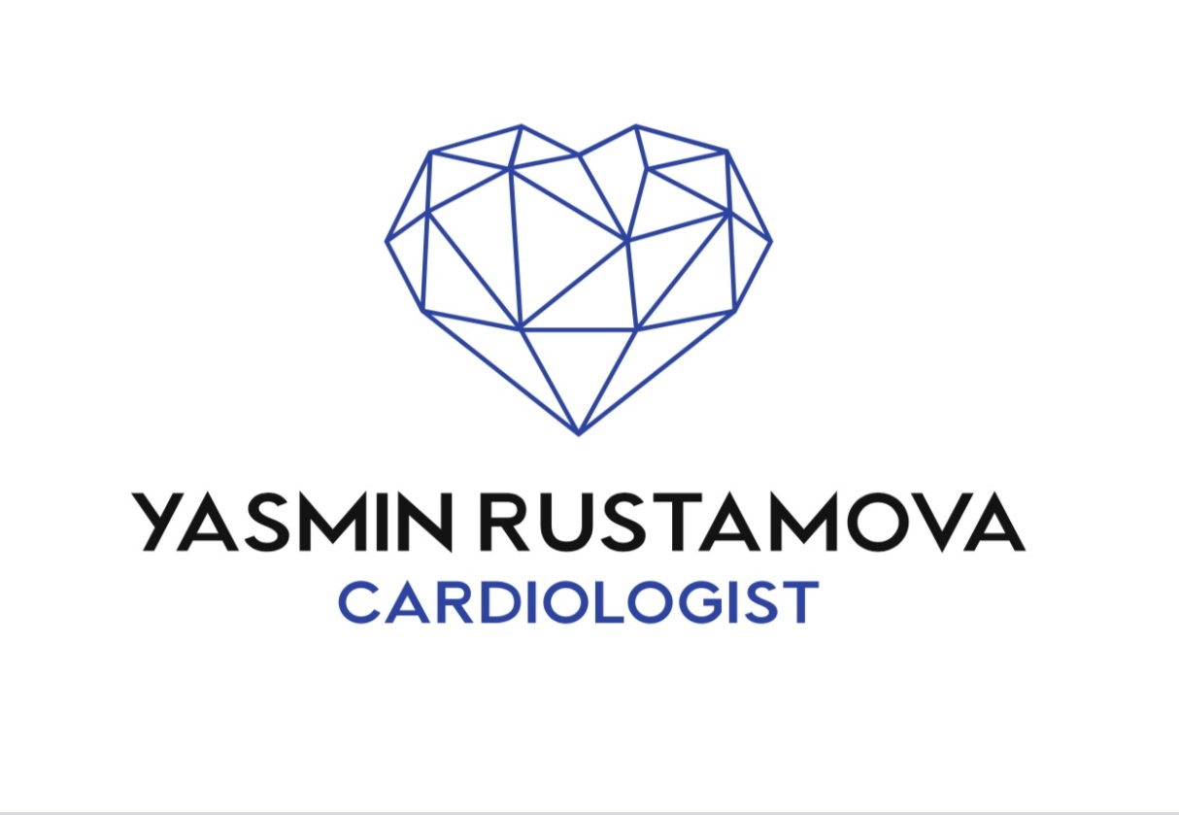

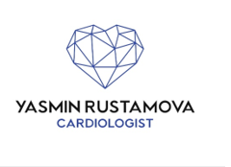
Thank you for attention !
yasmin.k.rustamova@gmail.com

